Slide 1
Kitchen Types

Slide 2
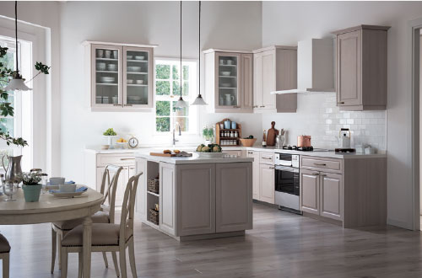
L type wall-mounting + Island
The L type is provided with a spacious island counter that is easy to use for making sweets and hosting parties. The rail and ornamental window made of natural wood create the feeling of the traditional, chic French kitchen.

Slide 3
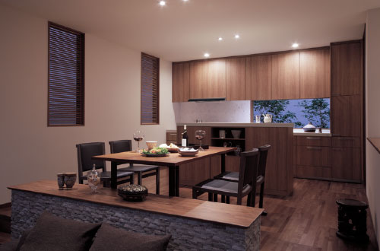
Ⅰ type wall-mounting + Small appliance, open counter
The villa-style kitchen makes you feel as if you are in the country-side. The cherry pattern door matches the floor to give the LDK a coordinated look.

Slide 4
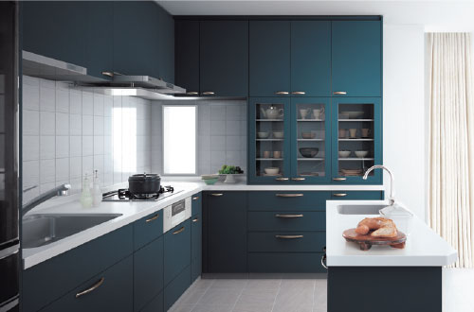
L type (I type layout) + Island
The sink and Hob are installed side-by-side on an L-shaped counter that ties in beautifully with the cupboard.

Slide 5
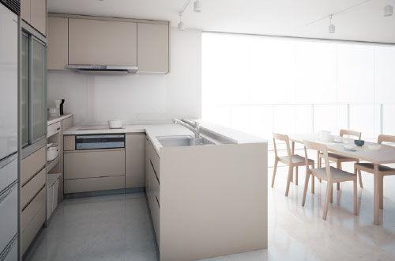
L type Low Step open + High counter
The compact layout smartly positions the kitchen system, the small appliance storage unit, and the dish storage units to best serve cooks. The low step counter hides hands from view behind a raised partition that works perfectly for serving and clearing the dining area.

Slide 6
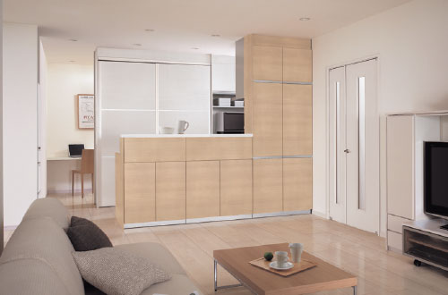
Ⅰ type High Step open kitchen (Peninsula)
This plan coordinates the colors of the kitchen and dining space, and provides a storage space for dishes and small appliances at the back of the kitchen.

Slide 7
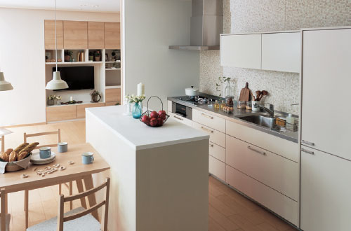
Ⅰ type wall-mounting + Hatch type, small appliance storage, high counter kitchen
Space for small appliances and trash bin is provided in the island unit. This plan is also recommended for condo renovation, considering the view from the living area.

Slide 8
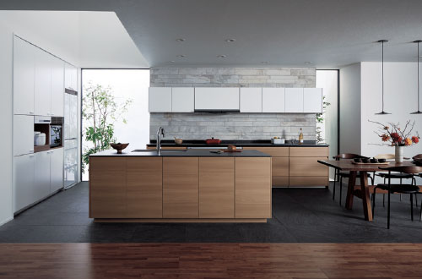
II type wall-mounting + Semi-floating type island kitchen
The slim counter and the detail of the stepped-in base molding offer a furniture-like feeling.

Slide 9
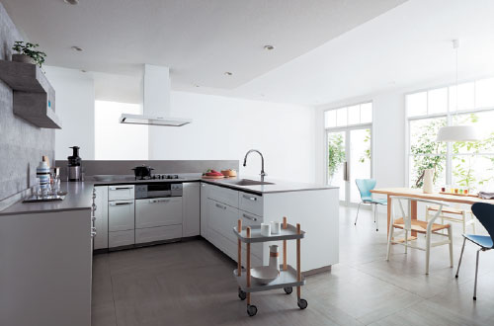
U-type flat, semi-floating type open kitchen
Designed with a counter having different depths on three sides, the U type kitchen plan secures a wide work area in a limited space. A popular option is to match the door and counter so that the look is simple but in good taste.

Slide 10
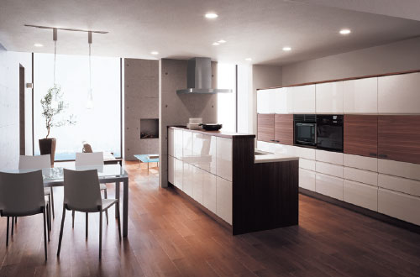
Open kitchen plan (Peninsula)
Mirror finish doors and natural wood. Coordinating different materials produces a modern look. The handlefree doors have a refined appearance.

Slide 11
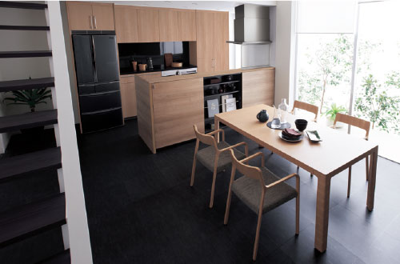
Smart Step open kitchen (Peninsula)
The island comes with storage space that is accessible from the kitchen and showcase shelving on the dining side for decorative items

Slide 12
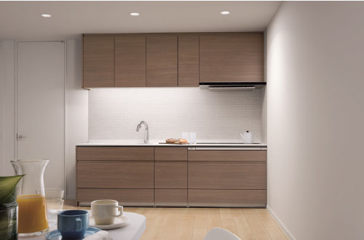
Ⅰ type wall-mounting kitchen plan
Counter with a slim approach and a riser beside the foot that enhance a furniture-like look. These features make a stylish impression.

Slide 13
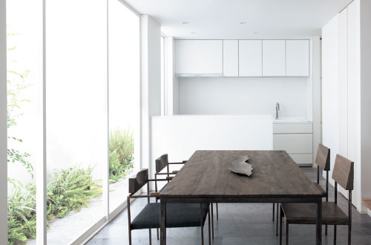
Ⅰ type wall-mounting + Hatch type, small appliance storage, high counter kitchen
An open counter capable of loosely partitioning the space is installed between the wall-mounting kitchen and the dining area. The high counter that stores small appliances and trash bin underneath is useful as a serving area facing the dining side.

Slide 14
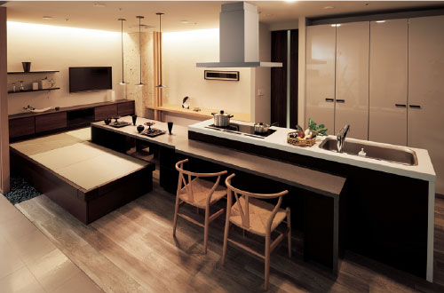
Ⅰ type island kitchen
This plan incorporates two sitting styles: one for “dining” and one for “gathering”.

Slide 15
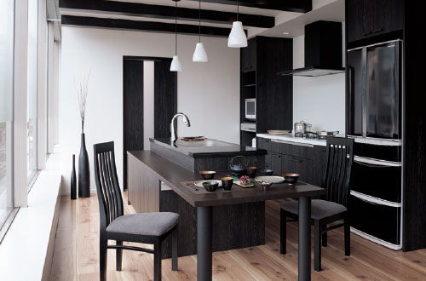
II type sink open kitchen
Remindful of an old farmhouse, this kitchen is perfect for spending time together and hosting parties.

