Slide 1
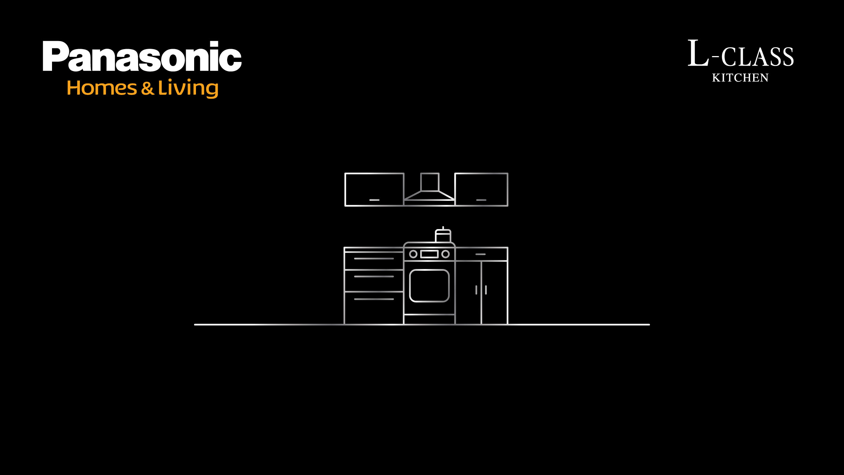

Slide 2

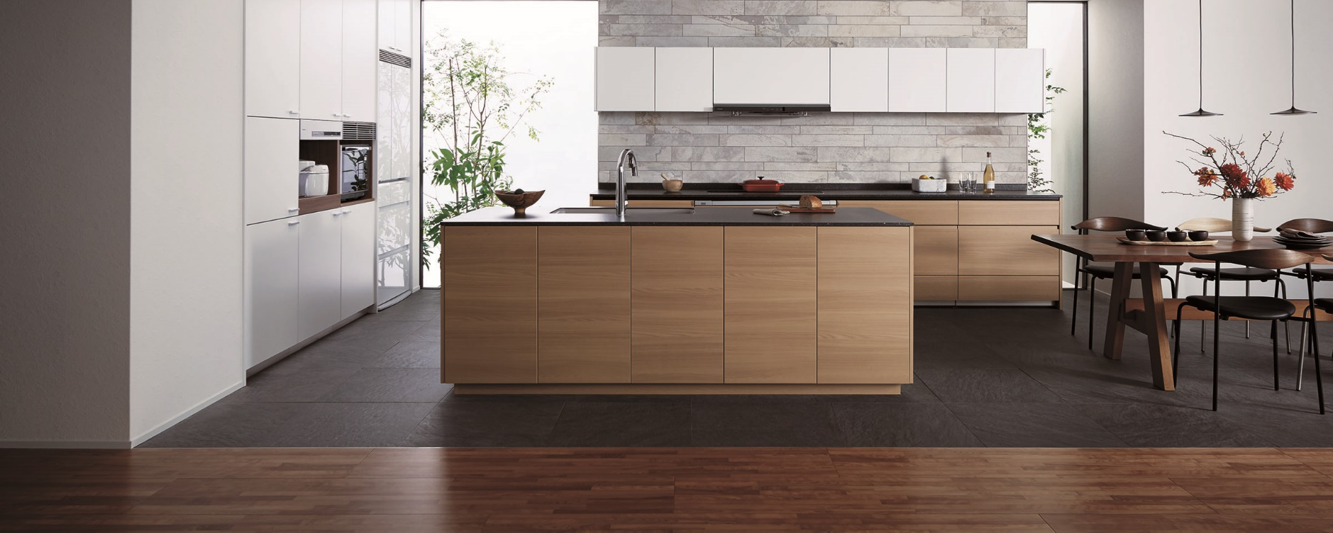
Welcome to Japanese Premium Luxury Kitchen Experience
Rahul Thakkar , GM- Housing Business

Slide 3
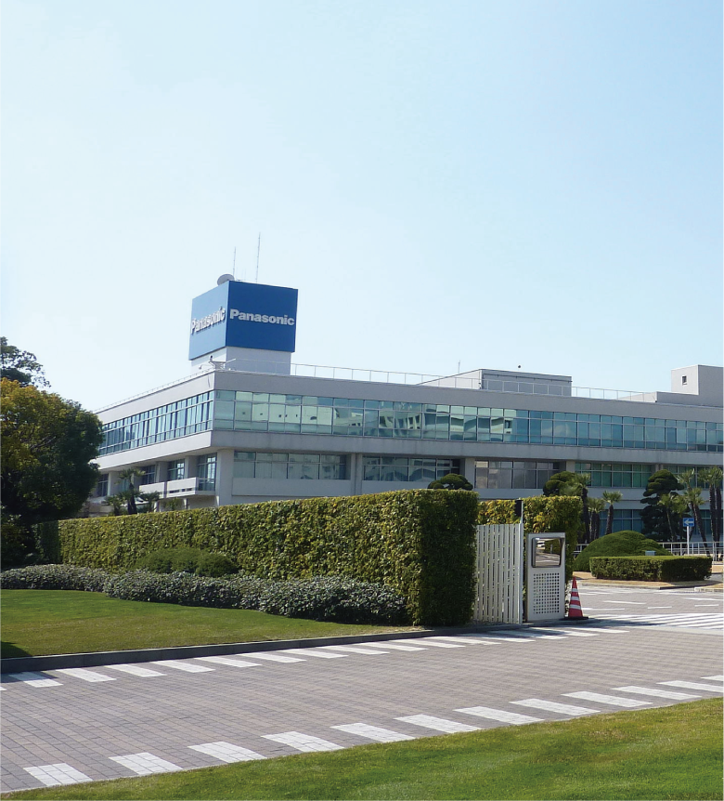


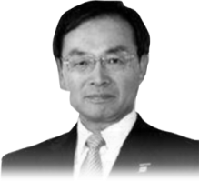
Company Overview
Global brand:
Company:
Panasonic Corporation
Foundation:
7th March, 1918
Head Quarter:
Kadoma, Osaka
President:
Mr. Kazuhiro Tsuga
Business:
Electronic Company providing a wide
range of products from audiovisual and information communication equipment to home appliances and components
Net Sales*: 90 billion USD
Number of employee*: 297,000
Number of Consolidated Companies*: 547
*as of December 31, 2019
Founded in 1918
by Konosuke
Matsushita (23)
Kazuhiro Tsuga
from 2012.6

Slide 4
Our Kitchen Systems are supported by
more than 58 years history and 6.5 million units in Japan
For more than 58 years, Panasonic’s commitment to creating kitchen systems
that help improve lifestyles and make living environments more comfortable has been constant.
The proof is in all the support and trust we enjoy from customers as well as
the cumulative sales of 6.5 million kitchen units to date. Over our long history,
we’ve developed and refined much data, ideas and
know-how that is uniquely ours.
65,00,000 Units & Counting

Slide 5
PANASONIC Advantage
100 Years Panasonic assurance and Trust with Made In Japan Quality
58 Years of Global Kitchen Experience
One of world’s largest Producer of Kitchen 3 Lacs Kitchens /Year
Globally 6.5 Mn (65 Lacs) Satisfied Customers
13 Plants Globally
Three State-of-Art plants in Japan and Global presence
In-House Technology for Producing Key Kitchen Components*

Slide 6
Panasonic Kitchen Solutions
Design
Function
Safety &
Maintenance
Customization

Slide 7
Digital Human
Simulations
Shi.ma.u
Concept
Design

Slide 8
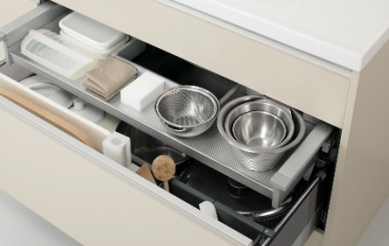
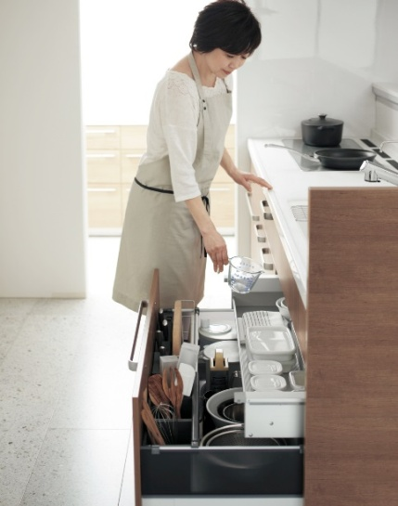
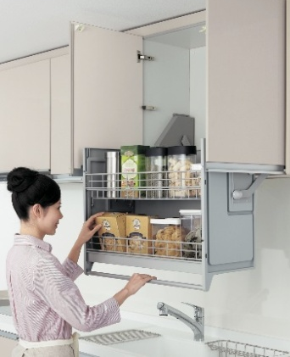
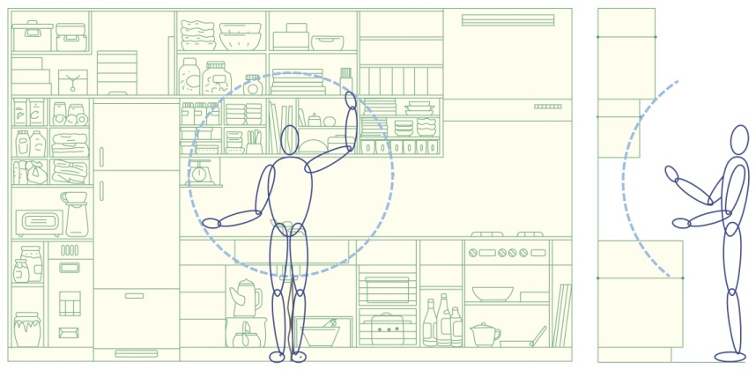
Our vision
We would like to
contribute to the
enjoyable cooking life
by Panasonic technology
SHI.MA.U
7

Slide 9
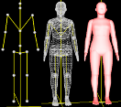

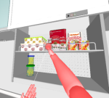
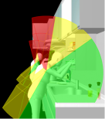
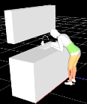
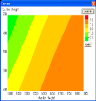
Digital Human Simulation Technology
Performance
Quantify the products’
user-friendliness by simulation
*Joint research with EPFL over Inverse Kinematics
Create human body models based on the database of 40,000 people (by age, gender, height and weight)
① Visual field
(Visible range)
② Physical compatibility
(Reachable range)
③ Physical load and the comfort (fatigue) range
Calculates the joint torque and converts to human sense.
負担感マップ
Sense of comfort(fatigue) map
Comfortable
カウンター高さ
Counter height
Uncomfortable
Hard
身長
Body height

Slide 10
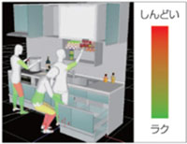
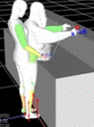
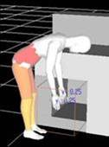
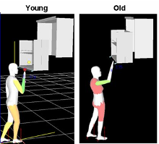
Digital Human Simulation Technology
Application Examples of Kitchen
Hard
Easy
Evaluation of suitable distance and height for human body
Red : muscle being stressed
Green : muscle being relaxed
Bending
posture
Distance to
counter shelf
Slide soft-down
wall shelf
Simulating the movement and the physical load using with/without the soft-down function

Slide 11
Key Products and Materials
Function

Slide 12
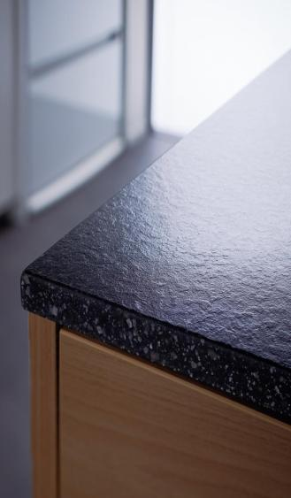
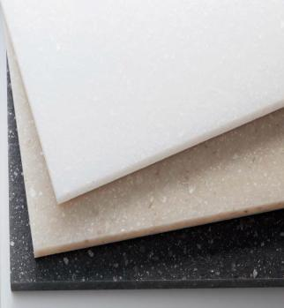

Panasonic Counter Top (New Engineered Marble)
Made of Mica and Glass with Slimmest Thickness Options
It has a texture similar to natural stone, Non porous ＆ easy to clean.

Slide 13
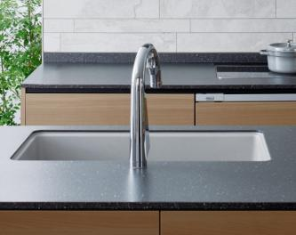
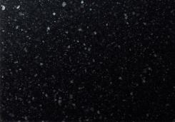
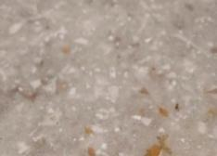

Counter Top
1
New material – Made of organic material, it’s hard & it repels water / oil, prevents dirt accumulation and is scratch-resistant with 12 color Shades
2
Embossing ensures high heat resistance up to 300 ℃
Black
Beige
White

Slide 14
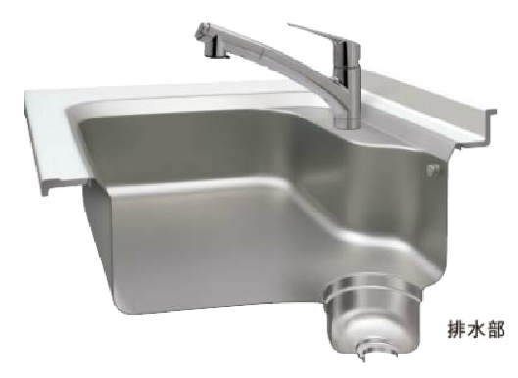
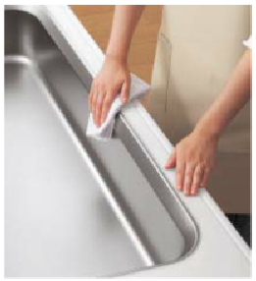
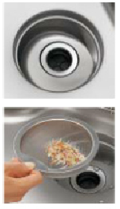
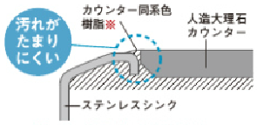
Panasonic - Stainless Steel Sinks with Surgical Grade
The SS sinks are completely seamless leaving no gap between the sink and countertop, which is very easy to clean.

Slide 15
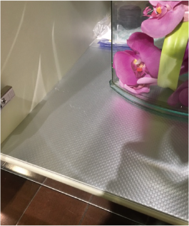
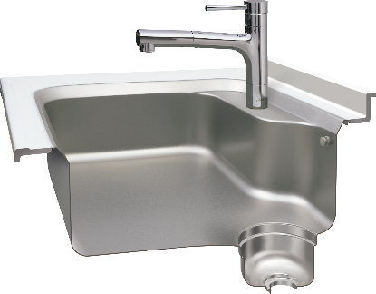
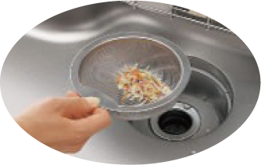
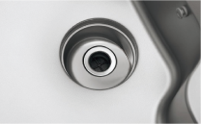
Seamless Sink
Feature
Emboss surface hard to be scratched
Easy to clean stains & dirt in drain hole
by Integral molding
Material
Aluminum bottom
Stainless Steel SUS304
Sink cabinet have water proof tough aluminum bottom
22

Slide 16
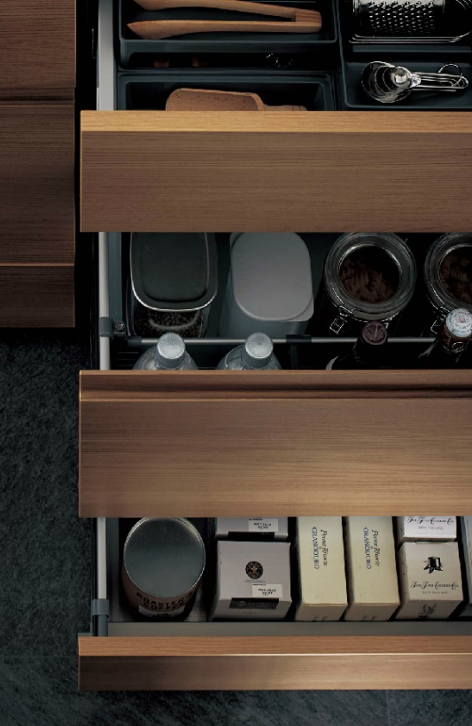
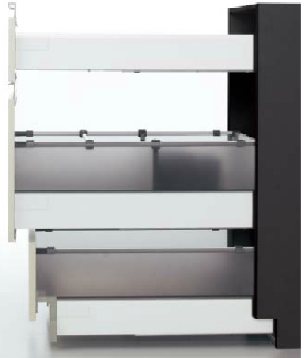
Unique Floor Stocker
“Floor Stocker”
Storage

Slide 17
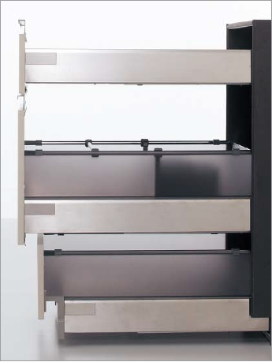
Internal Finish Of Drawers
Stainless Steel
Finish
White
Finish

Slide 18
Floor Stocker Model Allows extra Built-In Height
Each Drawer with Built In Extra Height to store Large Utensils / Big Groceries

Slide 19
Panasonic Kitchens Solutions
Safety &
Maintenance

Slide 20
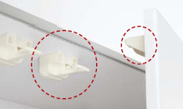
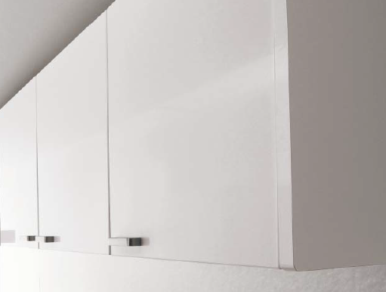
Built-In Safety Features
Anti Earthquake Locks
Rounded Edges of Side Verticals

Slide 21
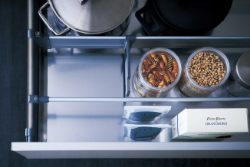
Built-in SS base
All Drawers are lined with Stainless Steel Mats

Slide 22
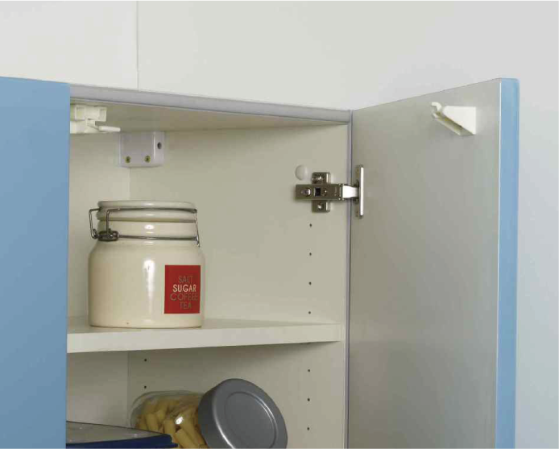
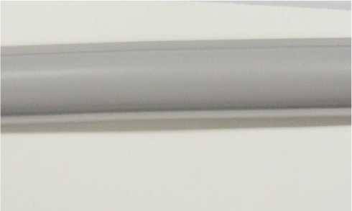
Smart Strip -Dust Free and Insect Free Cabinet
Smart Strip Stops Dust to enter in your cabinet and Stops insects and keeps kitchen Hygienic

Slide 23
Smart Customizations…
L-Class
Kitchen

Slide 24
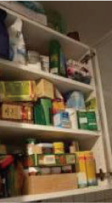
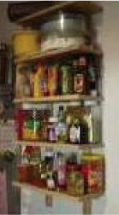
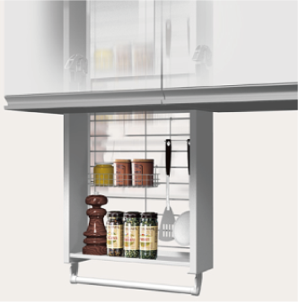

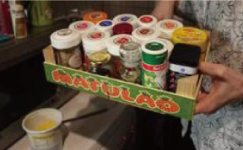
Pull Down Unit
Seasoning and cooking tools can be picked up and stored easily and rapidly.
You don`t have to prepare seasoning space on the work top while cooking.
Rear space of the cabinet can be used efficiently.
Pull Down unit
Seasoning is not conveniently stored
Quick & Easy, Store & Use
18

Slide 25
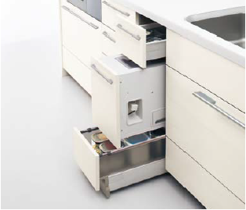
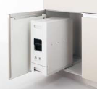
Smart Accessories – Rice Stocker
Rice Stocker – Attached With Door -12 Kgs

Slide 26
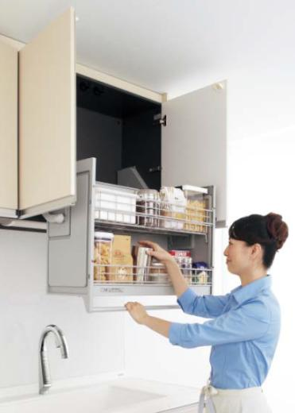
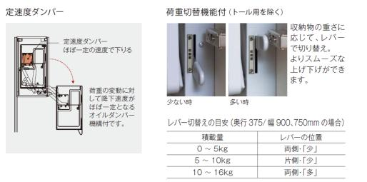
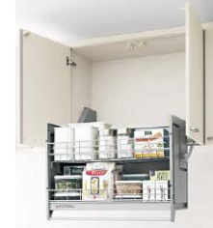
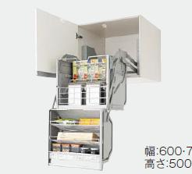
Single And Double Soft Down –Accessories Options
Smart soft Down
Ｄ３７５用
Ｄ６４２用

Slide 27
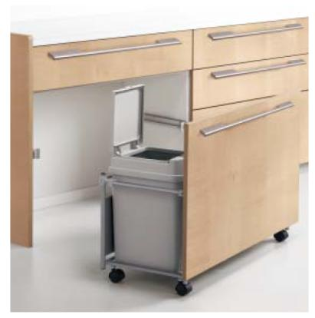
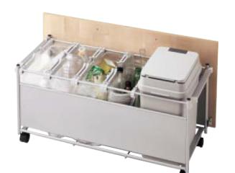

Smart Wagon Storage
Easy to segregate wet & dry. Deodorizing measures can also be added.

Slide 28





Accessories – Combination Palette
Easy-to-reach Storage that can store spices. It can also be used as temporary placement for dishes.

Slide 29



Cockroach Shocker Matt and Strip
TO BE INTRODUCED IN THE FUTURE :
Cabinet that keeps insects (such as cockroaches) away.
Surface of the material is such that it repels the insects through extreme discomfort when they come in contact with the surface. A method to prevent re-invasion and reduce insects.
Feel uncomfortable

Slide 30

Numerous variations of door panels
Durable and easy to clean – over 105 Options to select from
Classy leather print
(Samples shown below are some of the door panels available)
Super scratch-resistant glass surface
Natural wood surface
Fine vertical stripes
Textured horizontal stripes

Slide 31



Japan High quality standards and
strict quality review
300,000 open/close tested.
40,000 times tested.

Slide 32

Highest Quality Certified Board “F****” in Japan
- Comes under E1 standard of Euro Norms
- Highest Compressed Strength

Slide 33



Other International Certificates

Slide 34

Best Care in Handling Kitchen to Your Doorstep

Slide 35

Free Kitchen Design Services

Slide 36
Twice in a Year Free Kitchen check up till 3 years
10 Years Warranty
Free Pick up Drop for Store Experience
Easy Financial Options
One Point of contact for each category solutions like Cabinet/ Appliances/ Top etc.

Slide 37


Panasonic Homes and Living Experience Center, Bangaluru
Panasonic Homes and Living Showroom
80 Ft Road , Opp. FCML , Indiranagar, Bengaluru

Slide 38


